Slide 1

LONDON CRIME DATA ANALYSIS 2012 TO 2021
Presented by Group 12

Slide 2
The Team
Praneetha Kotta
Project Manager
Abdulrasaq Shittu
Datawarehouse Designer
Sandeep Babu Sampenga
Data Analyst
Neena Sebastian
Data Visualization Expert

Slide 3
Introduction
Problem:
The UK government is facing challenges in curbing the rising crime rates. The current law enforcement strategies are falling behind, and this has raised concerns about maintaining public safety. The government has recognized the need for innovative measures and believes that data analytics could offer new insights.
Solution:
To address this, the UK government has enlisted the expertise of the SHU Data Analytics team. By applying data analytics, the team has begun identifying patterns and trends within different crime categories and the corresponding police force areas. The initial focus is to pinpoint regions of concern. Following this, an in-depth analysis of factors like economic inactivity and social deprivation will be conducted to understand the underlying causes. The goal is to provide well-informed recommendations that could help reduce crime rates going forward.

Slide 4
Review the Scenario of the Proposal
Aspect | Previous Proposal | Updated | Reason for Change
Datasets Used | Crime Data Unemployment rates | Crime Data Unemployment rates Geographic data of London | Added geographic data to enhance spatial analysis and contextualize crime and unemployment data.
Business Questions | Questions focused on the correlation between crime rates and unemployment. | Revised questions to incorporate geographic analysis for a deeper understanding of spatial patterns. | To leverage the new dataset for comprehensive spatial analysis, providing richer insights into how geographic factors influence crime and unemployment.
Objective of Changes | Address crime related to unemployment. | Explore how geographic distribution impacts crime and unemployment correlations. | To provide more targeted insights and strategies for intervention by understanding the geographic spread.

Slide 5

Business Questions

Slide 6
Business Questions
1. What is the total number of crime per boroughs in each month from 2018 to 2021? | 2. What is the average unemployment rate among ethnic minorities UK national across the boroughs with the highest theft from person incidents from 2012 to 2021? | 3. What GLA constituencies do the boroughs with the highest crime rates belong to from 2016 to 2021?
Understanding the distribution of crimes over time and across different boroughs helps in making informed decisions to address crime rates effectively and enhance public safety. | It correlates unemployment rates among ethnic minorities with crime rates, specifically theft from person incidents, across different boroughs over a decade. This analysis can help identify if there's a pattern or correlation between economic hardship and crime rates, aiding in the understanding of socio-economic factors influencing crime.

Slide 7
Business Questions
4. What are the highest occurring crime types in every quarterly month from 2018 to 2020 and what are the corresponding white UK national unemployment rate during the same period? | 5. What are the highest occurring crime types in each boroughs from 2012 to 2021?
The analysis of patterns where higher unemployment may increase in specific types of crimes, thereby enabling a deeper understanding of socio-economic impacts on crime within these boroughs. Understanding these relationships can help in targeted interventions and policy making to address root causes of crime linked to economic conditions. | The most common crime types, authorities can develop targeted crime prevention strategies and better distribute resources. The chart demonstrates shifts and continuities in crime types over time, enhancing our understanding of how criminal behaviors develop or remain stable across different regions.

Slide 8

Data Key Features
Data Sets Evaluated | Features | Explanation
Crime data | Quantity: The data is over 10years span Granularity: The granularity of the data is month wise | The crime data contains dimensions such as 53 different crime types, dates (012011 - 122021) and 32 boroughs in London and a measure (number of crime)
Unemployment data | Quantity: The data is over 10years span Granularity: The granularity of the data is quarter-wise | The unemployment data contains just one dimension (Boroughs) and eight measures, which are unemployment rate among different age, UK born citizen, Ethnic minorities etc
Geographical data | Content: The data contains different administrative divisions within the London region, specifically focusing on boroughs, wards, LSOA etc | The geographic data zero measures and 5 different measures such as boroughs in London, the lower layer super output area, the ward name, the parliamentary constituency and the Greater London Authority constituency

Slide 9
Dataset Key features and Joins
Crime Dataset
Borough Name
Borough Code
Year
Month
Crime type
No of crime
Unemployment Dataset
Year
Quarterly Month
Borough Name
Borough Code
Unemployment rate white UK national
Unemployment rate aged 16
Employment
Civilian Labor Force
Unemployment
Unemployment Rate
Geographic Dataset
Borough Name
Borough Code
Ward Code
Ward Name
GLA Constituency
No of crime
Parliamentary Constituency
PK
PK
Data Transformation for Mapping
In integrating the crime, unemployment, and geographic datasets pertaining to London, the primary key used for joining would be the BOROUGH CODE. This key serves as the common identifier across the datasets, facilitating the correlation of crime rates, unemployment figures, and geographic attributes at the borough level for comprehensive analysis and decision-making

Slide 10
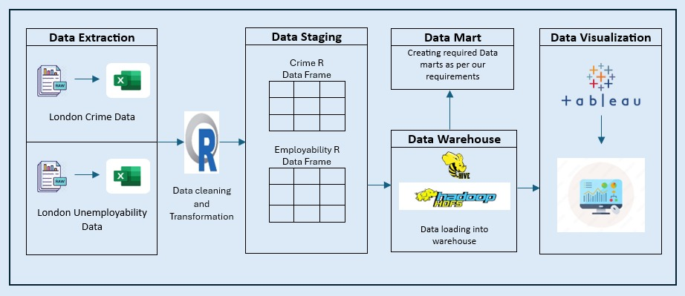
System Architecture
Future Development:
Integrate ML: Incorporate ML to automate decisions and derive complex insights.
Adopt Real-time processing: Implement technologies like Apache kafka for real time data processing.
Cloud based infrastructure: Transition to cloud plat form for enhanced scalability, flexibility and cost management.

Slide 11
Kimball’s (Bottom-up) Approach
Kimball’s approach builds data warehouse step by step, focusing on quickly meeting specific needs.
Using shared dimensions, the Kimball’s method keeps data consistent and makes it easier to use across different fact tables and data mart, which enhances data integrity and simplifies querying across the enterprise.
Ralph Kimball’s methodology prioritizes end-user accessibility and business intelligence, making it popular for organizations seeking to implement a data warehouse without extensive upfront planning and complex data modelling.

Slide 12

Agile Methodology
Agile methodology provides flexibility, which helps us to change plans easily.
Agile methodology is faster in showing results with the use of scrum.
By focusing on achievable goals, can avoid wasting time on things that might not be needed.
Larger projects are divided into bite-sized chunks called scripts and make them easier to manage.
Can get feedback from users and stakeholders throughout the project, to make sure by building the right strategy.
Short scripts made much easier to adjust the response to feedback
Daily scrum meetings allows everyone to stay on the same page and demonstrate their work.

Slide 13



Data Analysis & Visualization Tools
Open-source Programming language
Compact code for complicated steps
Can summarise the key characteristics of data.
Faster connection between hive and R
Handles structured data.
Data extraction is faster from Hadoop
Defining specific schemas is easy which are related to data analysis
SQL like Query in HIVEQL
Integration with Hive is easier
Better handling of
Larger datasets
Real time visualization

Slide 14
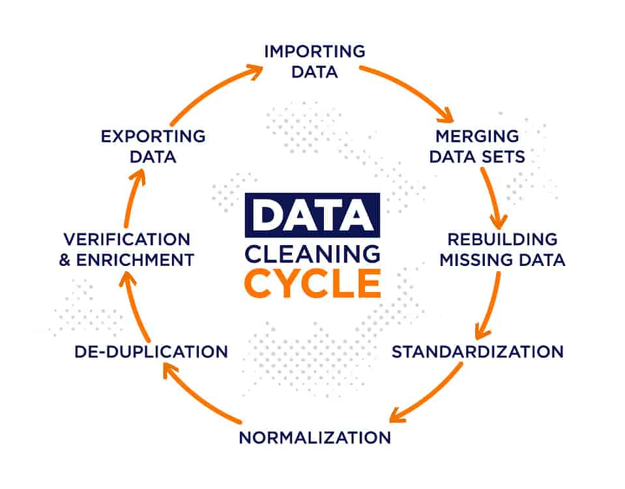
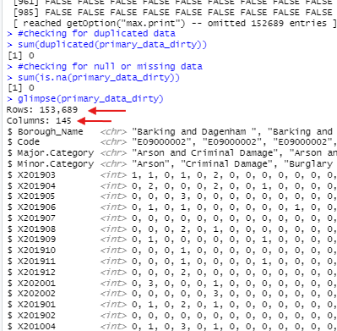
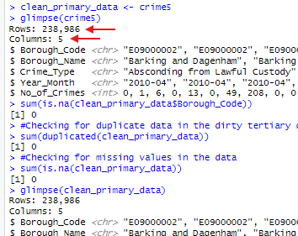
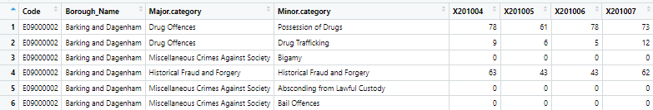
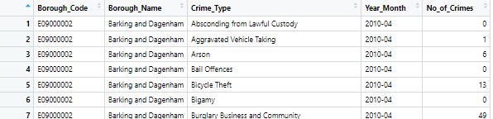
London Crime Dataset
EXTRACTION & TRANSFORMATION
No cleaning performed on primary dataset as extracted dataset was already clean
No null or duplicated values in Extracted & Transformed data
Increased Extracted Rows data due to transposing date (Year_Month) from columns to rows
Renamed column 'code' to 'Borough_Code' for uniformity across datasets
Removed 'Major.category' as it duplicates 'Minor.category'; renamed the latter to 'Crime_Type’ for proper Identification
Dataset comprises three dimensions; Borough Name, Crime Type, Year_Month & one measure; No_of_crime
Extracted data
Transformed data
Extraction: All datasets (CSV) were loaded into R Studio for transformation & cleaning

Slide 15
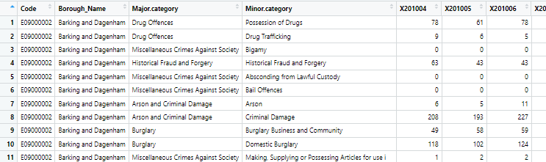
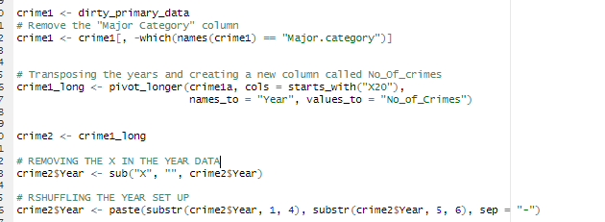
ETL Process: Data Cleaning & Transformation
London Crime Dataset
STEPS
Step 1: The major.category was removed as it is a repetition
Step 2: Transposing the dates using ‘pivot_longer() to rows and creating a new column for the total crimes
Step 3: Removing unwanted characters in the year column
Step 4: Renamed the columns to be in uniformity with the other datasets

Slide 16
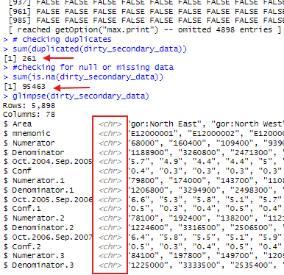
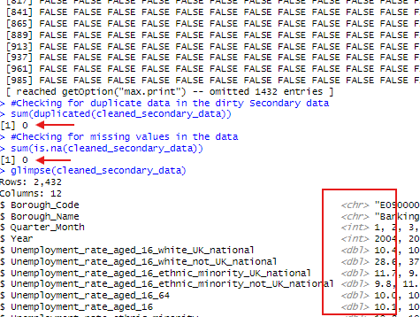
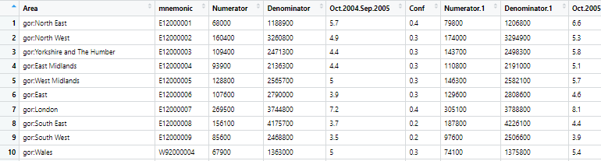
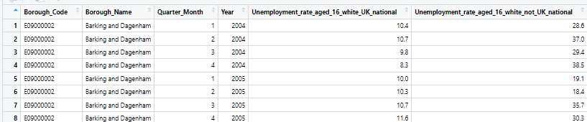
London Unemployment Dataset
EXTRACTION & TRANSFORMATION
Unemployment dataset: 261 duplicated rows, 95,463 null values
Extracted data rows reduced after removal of null and duplicated rows
Quarter dates transformed from 'chr' to 'Int' and separated into two columns
Renamed 'Area' to 'Borough_Name', 'mnemonic' to 'Borough_Code' for uniformity
Renamed column ‘mnemonic' to 'Borough_Code for uniformity across datasets
Extracted data columns in ‘chr’ converted to respective data types
Dataset includes 1 dimension & Eight measures (Various Unemployment rates among ethnic groups)
Extracted data
Transformed data
Extraction: All datasets (CSV) were loaded into R Studio for transformation & cleaning

Slide 17
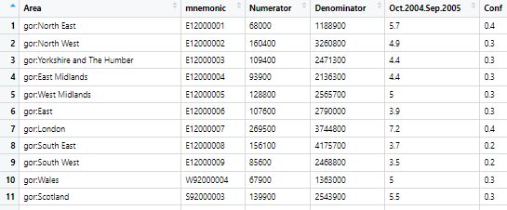
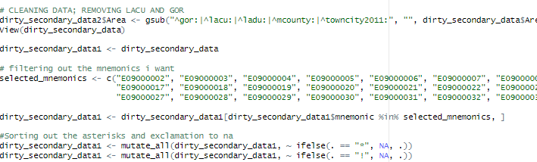
ETL Process: Data Cleaning & Transformation
London Unemployment Dataset
STEPS
Step 1: Removed unwanted prefix (gor:, lacu:, ladu:)
Step 2: Filtered out the mnemonic (Borough_code) related to London
Step 3: The dates were transposed to rows and divided into quarter months and years
Step 4: The null, duplicates and irrelevant columns were all removed
Step 5: Each Column were type converted to their respective datatypes

Slide 18
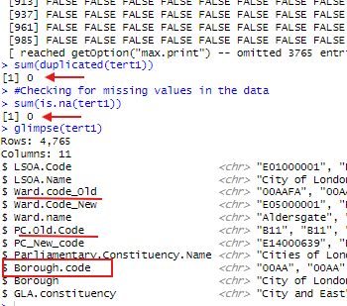
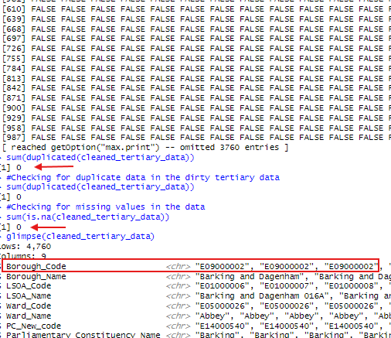
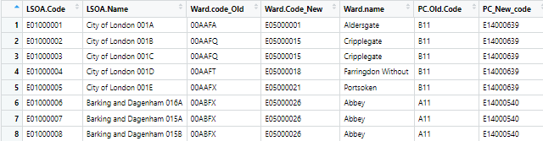
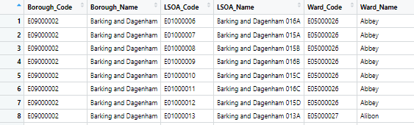
London Geographical Dataset
EXTRACTION & TRANSFORMATION
Little cleaning was performed on the Geographical dataset as the extracted dataset was free of duplicates and null value
The Borough code present in the dataset was an old one, so it was deleted likewise other old code such as ‘ward.code_old’ and ‘Pc_old.code’
A new Borough code was generated in relation to it Borough name as it is the primary key to the three dataset
Dataset includes 1 dimension & Eight measures (Various Unemployment rates among ethnic groups)
Extracted data
Transformed data
Extraction: All datasets (CSV) were loaded into R Studio for transformation & cleaning

Slide 19
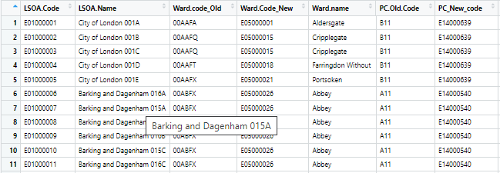
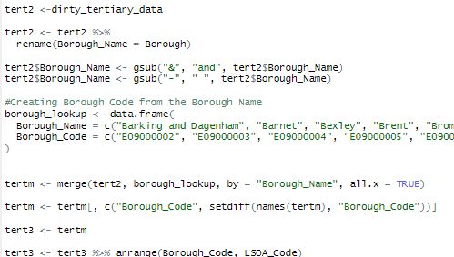
ETL Process: Data Cleaning & Transformation
London Geographical Dataset
STEPS
Step 1: Removed unwanted columns (ward_code_Old, PC.Old.code)
Step 2: Added a new Borough Code as the one in the extracted csv doesn’t correspond with the other datasets
Step 3: Made sure all Borough Name and Code are in the same format

Slide 20
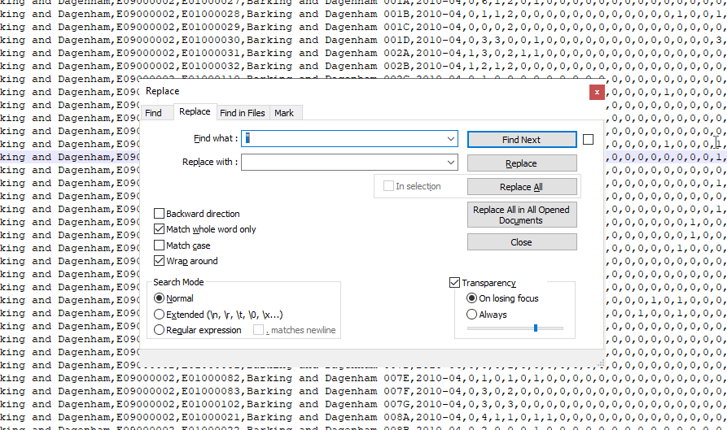
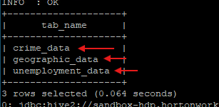
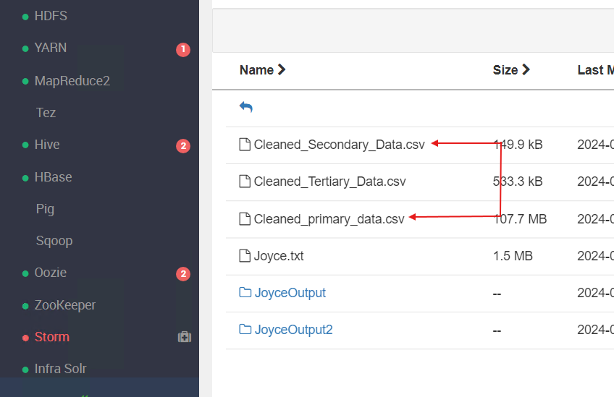
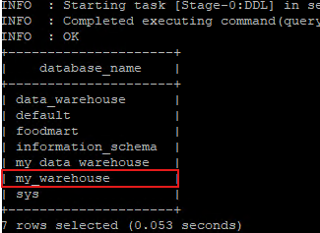
ETL Process: Data Loading
Step I: Already cleaned data ready to be moved to HDFS File Manager
Step IV: data stored in the warehouse created
"
Step II: Our dataset in HDFS FM, Ready to be loaded into HIVE
Step III: A data warehouse was created, ready to take in our datasets

Slide 21
DATA QUALITY & VALIDITY CHECK
Checking for Missing Data
Crime Data
Unemployment Data
Geographic Data
There are zero missing data in the three datasets

Slide 22
DATA QUALITY & VALIDITY CHECK
Checking for Duplicate Data
Crime Data
Unemployment Data
Geographic Data
The three datasets have no duplicate value

Slide 23
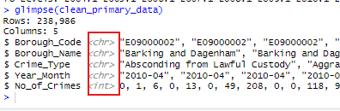
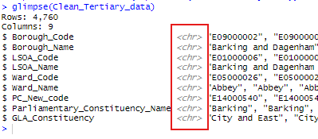
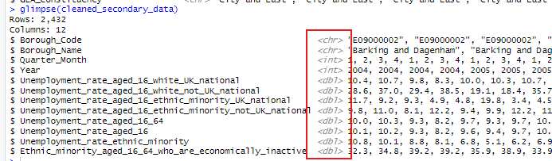
DATA QUALITY & VALIDITY CHECK
Checking for Datatypes
Crime Data
Unemployment
Geographic Data
The three dataset have their datatypes matched correctly, as the dimensions are in <chr> datatypes while the one in measures are in <dbl> and <int>

Slide 24
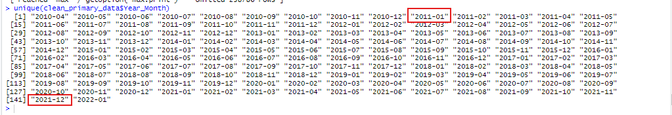
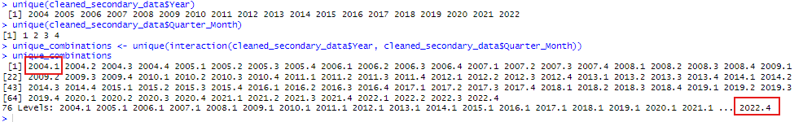
DATA QUALITY & VALIDITY CHECK
Data Validity Check
Crime Data
The crime dataset has it complete year & month 10years (2011 - 2021)
Unemployment Data
The unemployment data has it years from 2004 till 2022, the months are also in quarters
The primary dataset is a monthly dataset and passed the 10 years validity check, therefore we doing our analysis from Jan 2012 to Dec 2021
The secondary dataset is a quarterly month dataset (1: Jan - March,2:Apr - Jun), this was converted so we could have it easy while writing queries, we running our analysis from 1 2012 to 4 2021
These dates were picked for consistency reason between the dataset

Slide 25
DATA VALIDITY TESTING
 | Extracted | Transformed
Datasets | Rows | Columns | Rows | Columns | Difference | Comments
London Crime Data | 153,689 | 145 | 238,986 | 5 | 85,297 | Rows: Initially we have Raw Dataset count of 153,689 rows. Based on the business questions we are selecting we have changed some columns like years into rows which results in 238,986 rows. Total Duplicate Incident numbers & null values are 0. Columns: Columns are transposed to rows.
London Unemployment Data | 5,898 | 78 | 2,432 | 12 | 3,466 | Here, we have 261 duplicate rows and 95,463 null values
London Geographic Data | 4,765 | 11 | 4,760 | 9 | 5 | Total Duplicate Incident numbers & null values are 0.

Slide 26
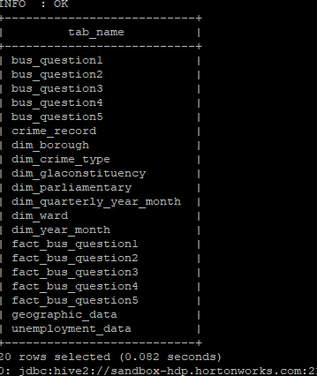
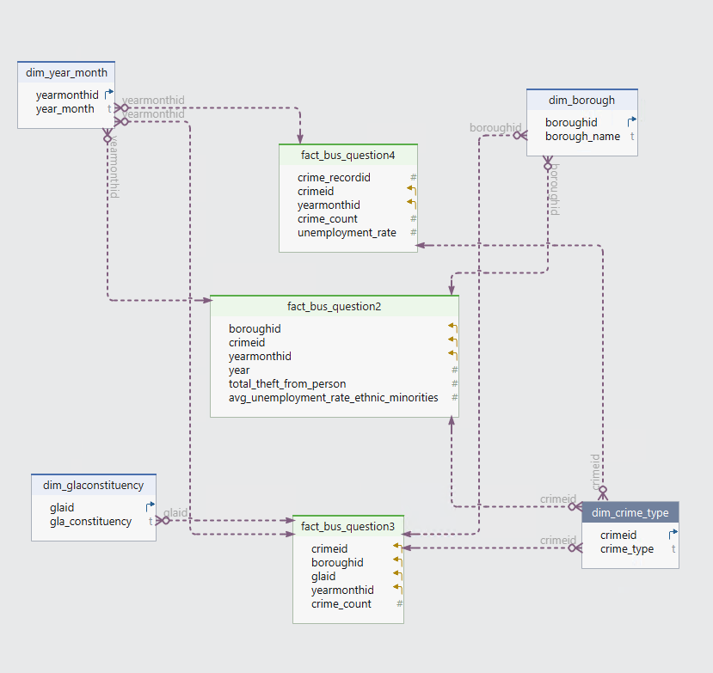
Constellation Schema
Created Tables in Hive using R Studio

Slide 27
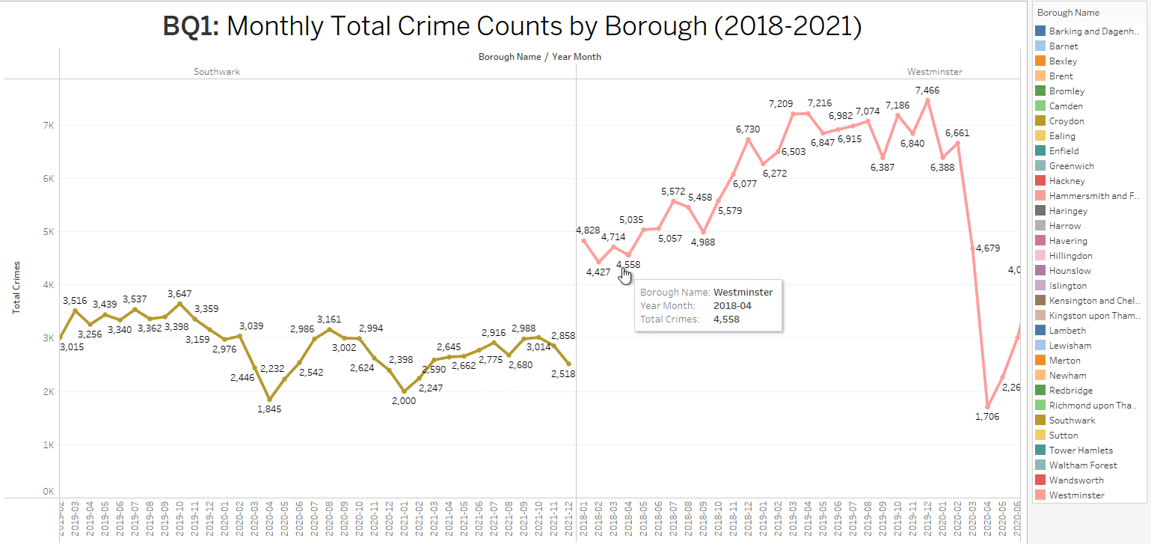
BQ1: What are the monthly total crime counts by Borough in 2018-2021?

Slide 28
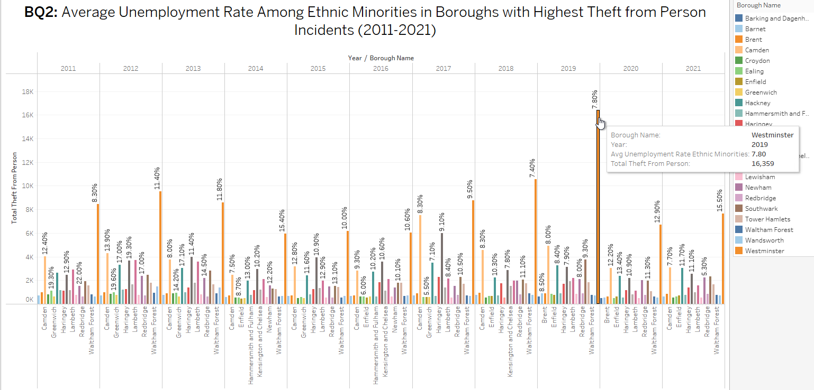
BQ2: What is the average Unemployment rate among Ethnic Minorities in Boroughs with Highest Theft from Person Incidents from 2011 – 2021?

Slide 29
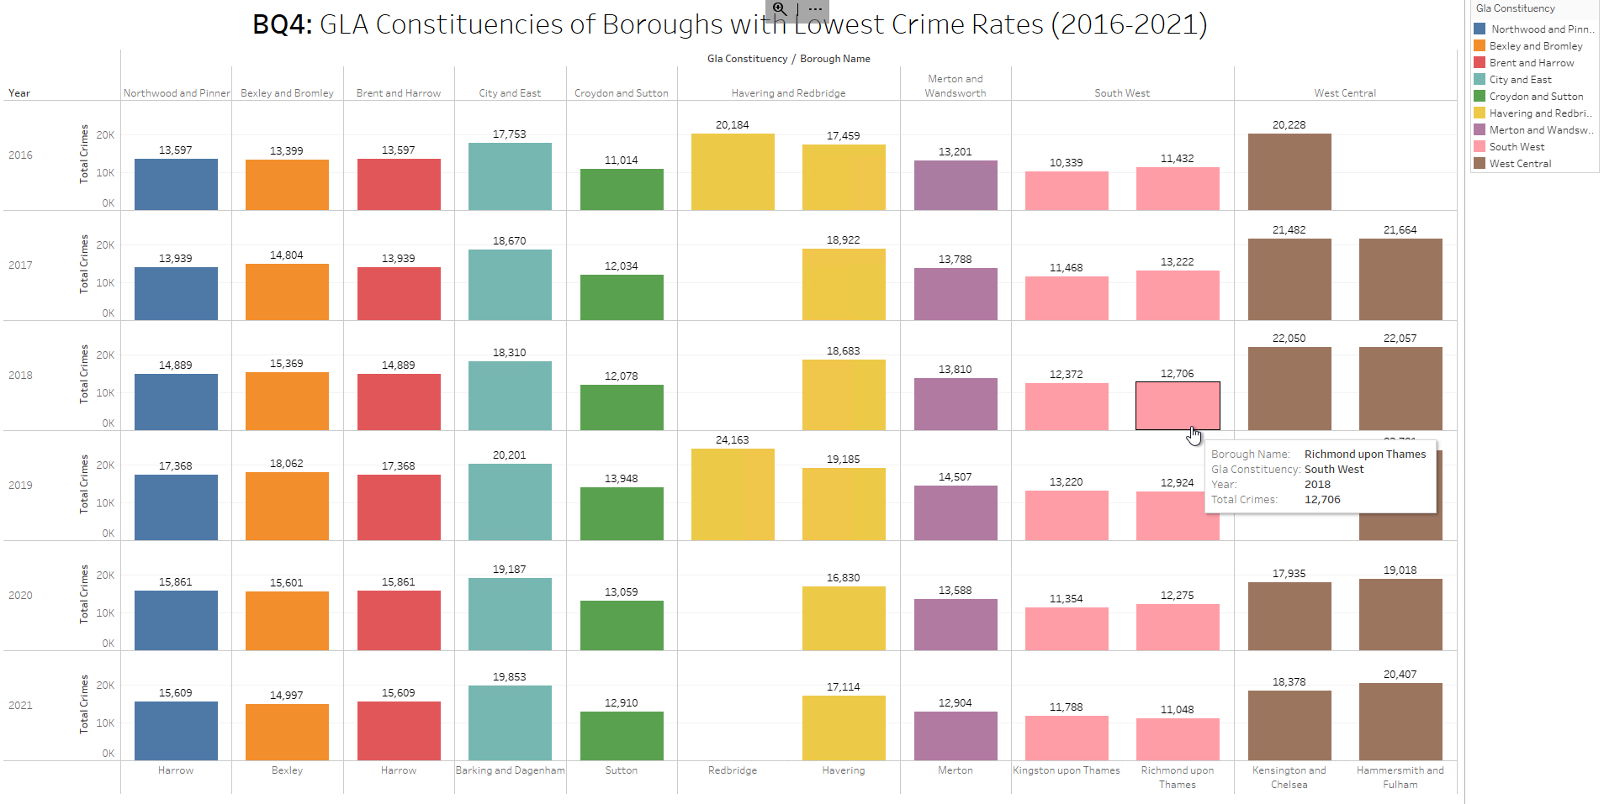
BQ3: What GLA Constituencies and Boroughs with Lowest Crime Rates from 2016–2021?

Slide 30
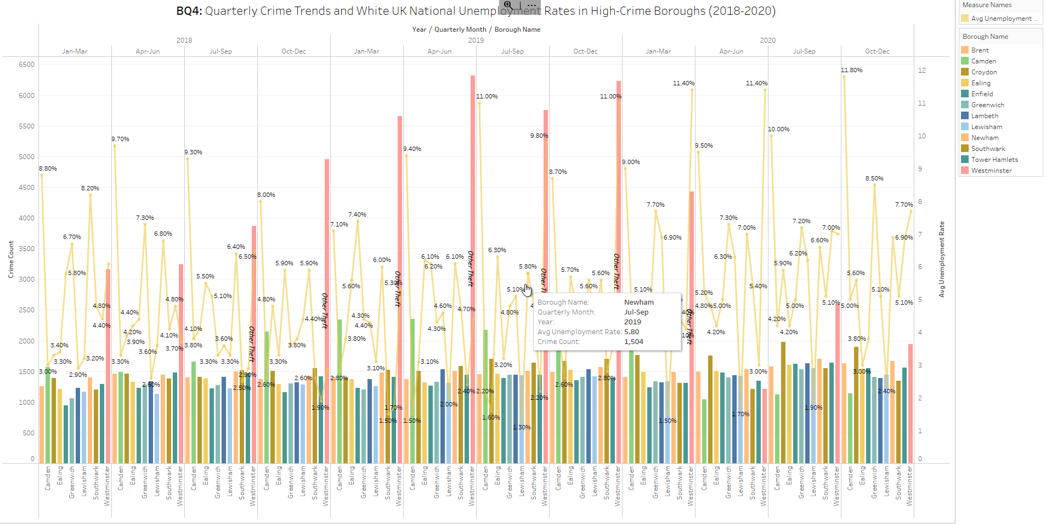
BQ4: What are the quarterly Crime Trends and White UK National Unemployment Rates in High-Crime Boroughs 2018-2020?

Slide 31
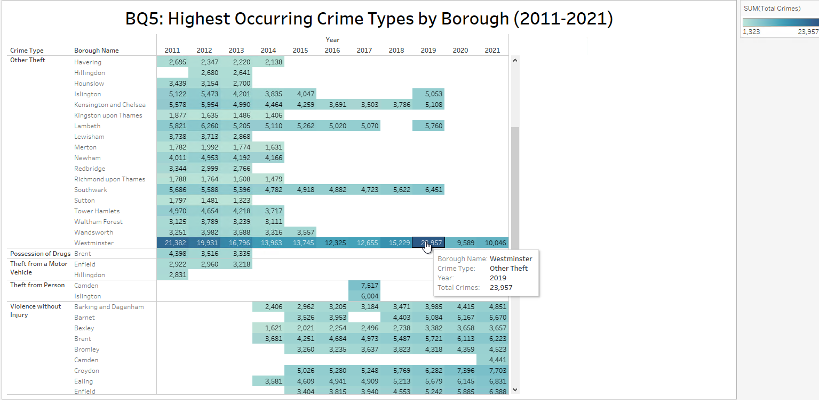
BQ5: What has the highest Occurring Crime Types by Borough from 2011 to 2021?

Slide 32
Final Recommendations Based on Project Results
Key Recommendations:
Localized Crime Prevention: Implement targeted programs in high-crime boroughs based on identified crime patterns.
Economic Support for Ethnic Minorities: Launch job creation and educational initiatives aimed at reducing unemployment among vulnerable groups.
Optimized Police Resource Distribution: Adjust police resources to match the crime rates in specific boroughs for better efficiency.
Community Engagement: Enhance public awareness and community involvement in crime prevention through outreach programs.

Slide 33
Scaling Up and Future Development Strategies
Strategic Vision for Future Expansion:
Real-Time Crime Data: Utilize real-time data processing for immediate crime analysis and law enforcement response.
Machine Learning Predictions: Develop predictive models to forecast crime trends and unemployment spikes, enabling proactive measures.
Cloud-Based Infrastructure: Migrate to a scalable cloud platform to handle increasing data volume and enhance analysis capabilities.
Collaborative Innovation: Partner with tech firms and academic institutions to refine data-driven crime prevention strategies.
Continuous Improvement: Establish a feedback system with stakeholders to continuously refine and adapt strategies based on effectiveness.

Slide 34

SHU Consultancy

